Slide 1



Telecom Customer Churn Prediction
This presentation explores the challenge of predicting telecom customer churn using various machine learning models. We delve into the data preprocessing, model training and evaluation, and finally, present the chosen model's performance and insights.
By Shivam Vishwakarma

Slide 2


Project Overview
1
Objective
Predict customer churn with high accuracy using machine learning.
2
Dataset
Leveraging a comprehensive telecom customer churn dataset for model training and evaluation.
3
Models Evaluated
Four prominent machine learning models were evaluated: Logistic Regression, Support Vector Machine, Naive Bayes, and Random Forest.
4
Chosen Model
Logistic Regression emerged as the chosen model based on its balanced performance across key metrics.

Slide 3


Data Preprocessing
1
Irrelevant Columns Dropped
Columns like customerID, irrelevant for prediction, were removed.
2
Missing Value Handling
Missing values in TotalCharges were addressed by imputation techniques, ensuring data integrity.
3
Feature Encoding
Categorical variables were encoded using label encoding and one-hot encoding for model compatibility.
4
Feature Scaling
Features like tenure, MonthlyCharges, and TotalCharges were scaled using MinMaxScaler for optimal model performance.

Slide 4
Model Training and Evaluation
Data Splitting
Evaluation Metrics
Model Training and Evaluation Process
The dataset was split into 80% for training and 20% for testing, ensuring reliable model evaluation.
Accuracy, precision, recall, and F1 score were employed to comprehensively evaluate model performance.
Each model was trained on the training data and then evaluated on the testing data using the aforementioned metrics.

Slide 5
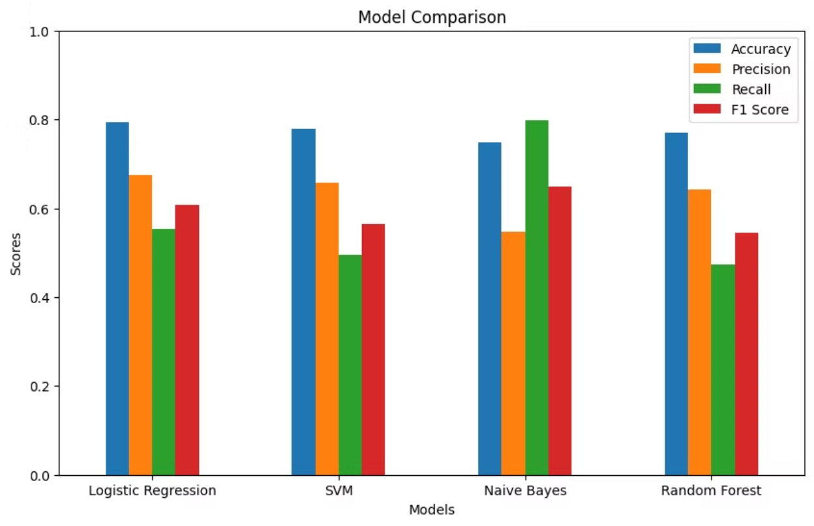
Model Comparison

Slide 6


Logistic Regression Performance
Metric
Score
Accuracy
0.793177
Precision
0.674627
Recall
0.553922
F1 Score
0.608345

Slide 7

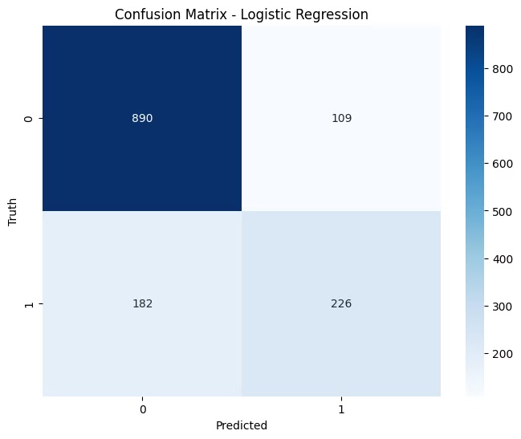
Confusion Matrix - Logistic Regression
True Positives : 226
Customers correctly predicted to churn.
True Negatives : 890
Customers correctly predicted to not churn.
False Positives : 109
Customers incorrectly predicted to churn (Type I Error).
False Negatives : 182
Customers incorrectly predicted to not churn (Type II Error).

Slide 8
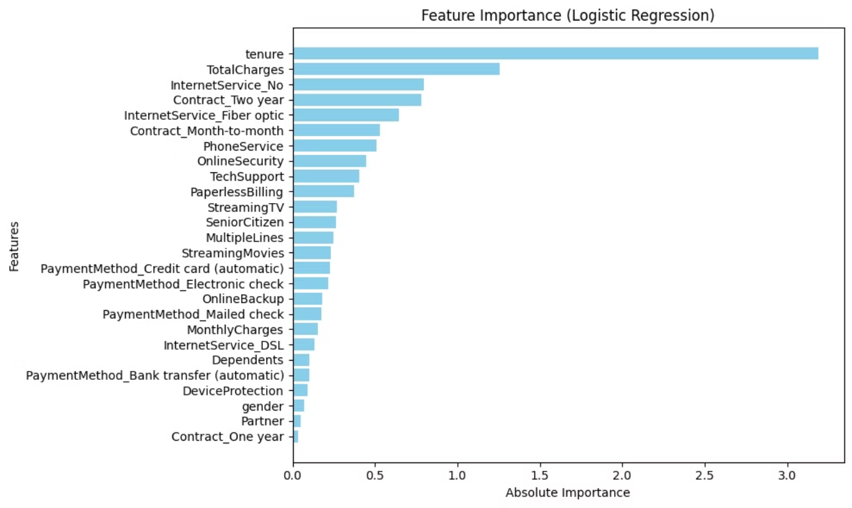
Important Features

Slide 9




Conclusion
Logistic Regression
The chosen model for predicting customer churn due to its balanced performance across key metrics.
Key Insights
Logistic Regression provided a good trade-off between precision and recall, making it a reliable choice for predicting customer churn in this context.

